Slide 1

NATURAL PESTICIDES
Lecturer: Pharm (Mrs) M.N Adebowale
Course: PCG 302 (Phytochemistry II)
Department of pharmacognosy
Faculty of pharmacy
Olabisi onabanjo university

Slide 2
PEST
Pests are living organisms that are found where they are unwanted and causes damages, injuries or destructions to crops, humans or other animals.

Slide 3
PESTCIDES
Pesticides are substances or mixtures of substances intended for preventing, destroying, repelling, or mitigating any pest.
They are a range of products used to control pests such as rats and mice, weed, insects, mold or fungi, slugs.

Slide 4
Classification of Pesticides
PEST | PESTICIDES
INSECTS | INSECTICIDES
WEEDS | HERBICIDES
FUNGI | FUNGICIDES
RODENTS (RATS/MICE) | RODENTICIDES
SLUGS/SNAILS | MOLLUSCIDES
NEMATODES | NEMATICIDES

Slide 5
Pesticides of Botanical Origin
There are two categories of Pesticides, those from natural sources and the synthetic ones.
Pyrethrum is a pesticide from a botanical source and several synthetic compounds like Pyrethrum have been developed.
such as synthetic pyrethrin-like compound- allethrin
Pyrethrum is from the dried flower heads of Chrysanthemum cinerariaefolium, family Compositae
They are cultivated in Kenya, Tanzania, Rwanda, Japan, Eastern Europe, Brazil, and India.

Slide 6
PYRETHRUM
Kenya has an altitude of about 1,900-2,700m and an annual rainfall of 76-180cm.
The altitude is important and gives a low night temperature of 5-15⁰C which stimulates bud production.
9% of insecticidal activity are in the flower which are harvested for about 9months in a year.
Though the Pyrethrum flowers are not toxic to insects before drying.
The closed flower – heads are about 6-9mm in diameter and about 9-12mm in diameter when opened.

Slide 7
Characteristics of the Insecticides from the Chrysanthemum species
Other species used as insecticides include Chrysanthemum coccineum and Chrysanthemum marshalli.
The powder of the Chrysanthemum species has parenchyma with aggregate crystals, T shaped hairs, several spherical pollen grains.
The Kenya flowers contains not less than 1.3% Pyrethrin, the Japanese has 0.9 – 1.0% and the Dalmatian about 0.7-0.8%.
The insecticidal properties in Pyrethrum are due to two groups of the esters:

Slide 8
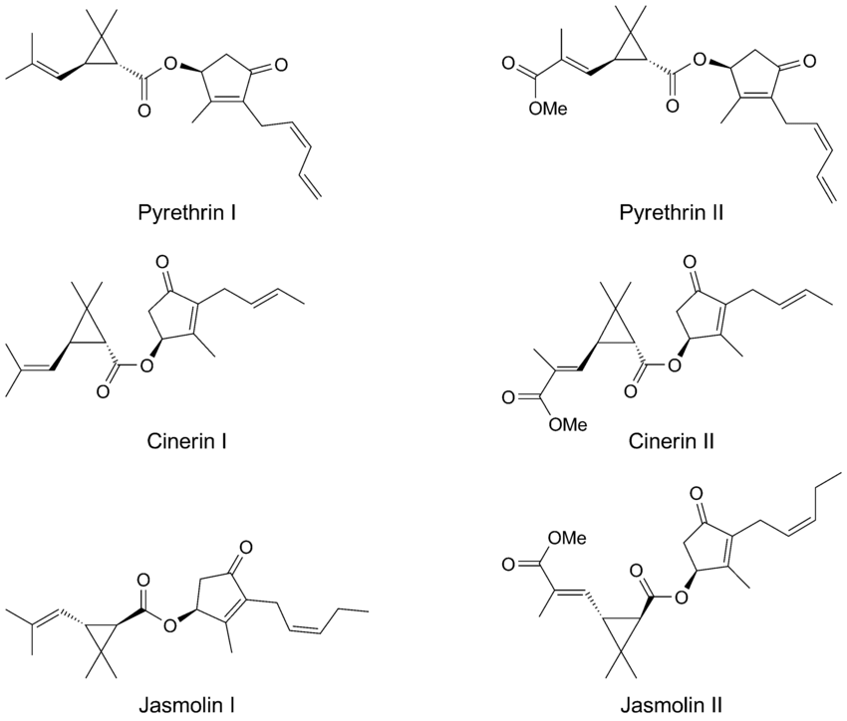
CHEMICAL STRUCTURES OF PESTICIDES
1. Pyrethrin I, Jasmolin I, cinerin I are esters of chrysanthemic acid (chrysanthemum monocarboxylic acid).
2. Pyretrin II, Jasmolin II and Cinerin II are esters of pyrethric acid.

Slide 9
Products with Pyrethrum and Pyrethrin
The pyrethrum extract is used in the preparation of dusting powder and the powder has about 0.36-0.44% pyrethrin, half of which is pyrethrin I.
In addition, some of the commonly sold Insecticides have certain percentages of Pyrethrin

Slide 10
Effect of Pyrethrum or Pyrethrin of botanical sources on Insects?
It exhibits a knock-down action (which is due to pyrethrin II).
Lethal to insects (Pyrethrin I)

Slide 11
Advantages of using Pyrethrum and Pyrethrin Products from Natural Sources
They are biodegradable
They have high potency and selective toxicity
Ability to reduce disease transmission
They are cost effective
They are relatively stable in the environment

Slide 12
Side effects of synthetic insecticides
Environmental pollution
Health hazards
Resistance of insects and pest resurgence
The synthetic analogues of pyrethrum possess higher insecticidal effects (about 1,000 times higher) than that from natural sources, and are more photostable.
These characteristics have displaced preference for natural pyrethrin. However, they are still useful in food processing (insecticidal spraying of edible fruits and vegetables shortly before harvesting).

Slide 13
Other Botanical Sources of Pesticides
Dried rhizomes and roots of Derris elliptica, D. malaccensis; family Leguminoseae
Dried roots of Lonchocarpus utilis, L. urucu; family Leguminoseae
Derris spp and Lonchocarpus spp contains about 3-10% rotenone (flavone derivatives), a colourless crystalline substance which is insoluble in water but soluble in organic solvents.
Nicotiana tabaccum and other species of Nicotiana are sources of insecticides of plant origin. (Nicotine, Nornicotine, anabasine all exhibit insecticidal properties).

Slide 14
Other Botanical Sources of Pesticides
Artemisia argyi was investigated for its ability to kill the grain insect; Lasioderma serricorne (cigarette beetle) responsible for destroying insect pests of stored cereals, tobacco, oil seeds, dried fruits.
The essential oils present in the plant proved effective against the pest insects. The oil contained eucalyptol, B-pinene, B-caryophyllene, camphor, thujone and other compounds.

Slide 15
Larvicides (Plants with Larvicidal Activities)
Larvicides are insecticides which eliminate pests before they develop into Adult stage that is, they destroy the larva stage.
This is used in the elimination of the larva of the Anopheles spp, Culex pipens.

Slide 16
Examples of Larvicides from the Nigerian Flora
Azadirachta indica (Neem), Citrus spp, Mangifera indica, Cocos nucifera, Anacardium occidentale, Ricinus communis
Paullina pinnata, Buccholzia coriacea and Funtumia africana were all tested against the third and fourth instar larvae of Anopheles gambiae and Culex pipens respectively.

Slide 17
Herbicides
Herbicides are compounds used to control weeds particularly those who compete with crops for edaphic resources (water, nutrients), space and sunlight.
Many weeds are hosts of pathogens which in turn lead to occurrence and spread of plant diseases.
Some botanical herbicides include: Phytophthora palmivora for the control of stranglervine (Morrenia odorata) in Citrus Plantations.

Slide 18
Schistosomiasis
Schistosomiasis (Bilharzia) is an acute and chronic disease of humans caused by parasitic flatworms (trematode worms) called Schistosomes in the Tropical and Subtropical Countries.
The freshwater snails act as intermediate hosts for the blood flukes causing the disease.

Slide 19
Symptoms of Schistosomiasis
Blood in urine (haematuria)
Abdominal pains
Blood in the stool
Diarrhoea
Rash
Itchy skin
Chills
Cough
Headache
Stomach pain
Joint pains
Muscle aches

Slide 20
Schistosomiasis Life Cycle
This disease causes intestinal and bladder damage.
When people suffering from Schistosomiasis contaminate fresh water sources with excreta and urine containing the parasite eggs, these hatch to miracida in the water
Which then locates the freshwater snail and develops into sporocyst, these sporocyst grow and are then released by the snail as cercaria.
These larva form of the parasite infects humans when released by the freshwater snails by penetrating the human skin during wading in infested water.

Slide 21
Schistosomiasis Life Cycle
They then shed their forked tail to form a schistosomula.
In the human body the larva develops into adult schistosome which lives in the blood vessels where the female releases eggs and are passed out of the body in the faeces and urine to continue the life cycle.
A few others remain in the human body causing damages to the intestines and bladder.
Schistosoma mansoni, Schistosoma haematobium are prevalent in Africa others are Schistosoma japonicum, Schistosoma mekongi.

Slide 22
Schistosomiasis Life Cycle
S. haematobium infects snails of the genus Bulinus.
S. japonicum infects snails of the genus Oncomelania.
S. mekongi infects snails of the genus Neutricula
S. mansoni infects snails of the genus Biomphalaria
A means of preventing Schistosomiasis is by eliminating the snail hosts.
One of the ways this can be achieved is by using pesticides known as Molluscicides for this purpose.

Slide 23
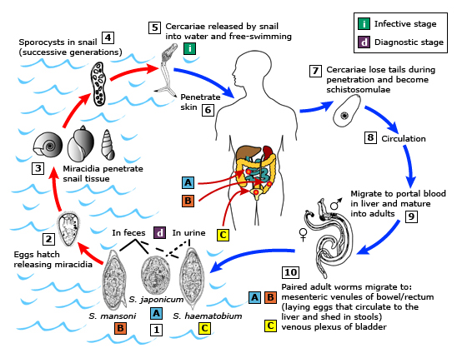
Schistosomiasis Life Cycle -Life cycle of S. haemotobium, S. mansoni and S. Japonicum

Slide 24
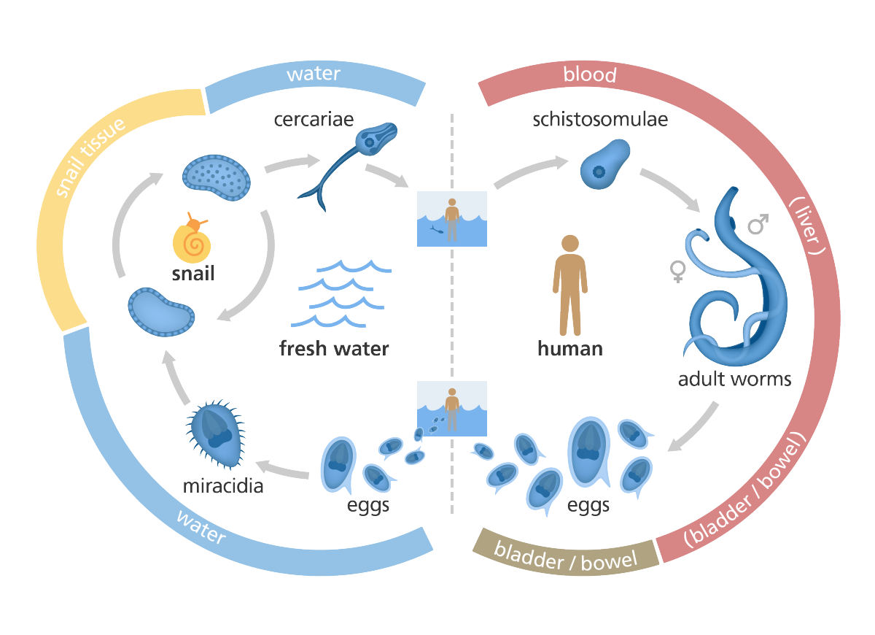

Slide 25
Molluscicides
Molluscicides are pesticides used to eliminate slugs and snails that are responsible for destruction of food plants and who act as agents for disease-causing organisms.
There are two types of Molluscicides: Synthetic and Natural Molluscicides.

Slide 26
Molluscicides of Plant Origin
Members of the families Leguminosae, Araliaceae, Asteraceae and Liliaceae have been identified as main sources of Molluscicides.
Molluscicide of plant origin are preferred because:
They are ecologically friendly
Biodegradable
Culturally acceptable
Readily available
Cheaper
Less polluting than the synthetics
A self-reliant control strategy

Slide 27
Molluscicides of Plant Origin
One of such plants is the Ethiopian plant (the soap berry) Phytolacea dodecandra
which is effective in the waterways of snails.
Another of such plant is Swartzia madagascariensis (Leguminosae) found throughout Africa
It exhibits folklore medicinal Molluscicidal and insecticidal uses

Slide 28
Molluscicides of Plant Origin
The spirostanol saponins, from Balanites aegyptiaca are potent molluscicides.
Balanitin 1,2,3 have been isolated from this plant.
Furthermore, linalool from Cinnamomum camphora (L) extracts has been used to eliminate Oncomelania hupensis snails.
Linalool therefore could also be used to treat Schistosoma japonicum infection.

Slide 29
Effect of the molluscicides on the host snails
Muscular and spiral twisting of the snail body
Destruction and cell degeneration
Shrinking of the hepatopancreas of the snails
Other Plants that have also exhibited Molluscicidal activities include:
The aqueous extracts Thevetia peruviana, Alstonia scholaris and Euphorbia pulcherrima as well as the latex of Euphorbia hirta.

